Slide 1
Platform of Content Management System is - Shopify
By Achal Gupta

Slide 2
What is shopify?
Shopify is a Canadian multinational e-commerce company. It is also the name of its proprietary E-Commerce platform for online stores and retail point-of-sale systems.
Revenue: 158 crores USD (2019)
Founded: 2004
CEO: Tobias Lütke (Apr 2008–)
Headquarters: Ottawa, Canada
Subsidiaries: Oberlo, Tictail, Handshake Corp., Tiny Hearts Limited, MORE
Founders: Tobias Lütke, Daniel Weinand, Scott Lake

Slide 3
Basic Feature of shopify are:-
online store :- If our store is on the Basic Shopify plan or higher, then so we can create and customize an online store to showcase our products. we can manage all our products, orders, and customer information from our Shopify admin.
SSL certificate :- An SSL certificate is a security protocol that creates a safe connection between a server and a browser to keep our and our customers’ information secure.
More reports :- As well as finance reports, if we are on the Basic Shopify plan then we can access our store's acquisition reports, several behavior reports, and a marketing report. These reports can give us insight into our online store traffic to help us in expanding our business.

Slide 4
Advance Shopify Plane
Custom report builder:- Advanced Shopify allows us to create custom reports.we can customize default reports and create unique reports from scratch.
Advanced customer reporting:- Along with the Customer reports included with the Shopify plan, with Advanced Shopify we can access reports on our at-risk and loyal customers.
Calculated carrier shipping:- Calculated shipping let us integrate with a third-party shipping service to provide our customers with up-to-date shipping rates at the time that they place an order in your store. Your customers can also choose from various shipping options: standard, express, and one-day.

Slide 5
Why we use Shopify?
Big brands are using Shopify
You don’t have to worry about server costs
Discounts are offered on annual plans
Shopify has great app integrations with SaaS services
Security & Reliability

Slide 6
What make shopify different from other e-commerce platform.
shopify
magento
Take care of Hosting.
Free Domain Name
Automatic Backup
SSL certificate
Set up your own Hosting.
Cheaper packages might not help.

Slide 7
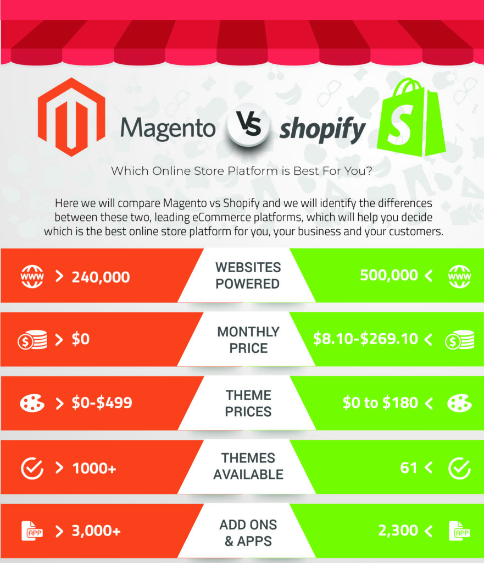
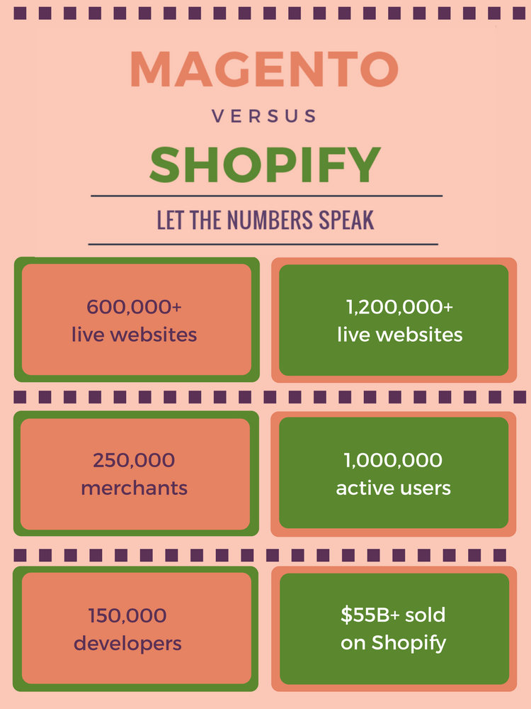

Slide 8
Difference between wordpress and shopify

Slide 9
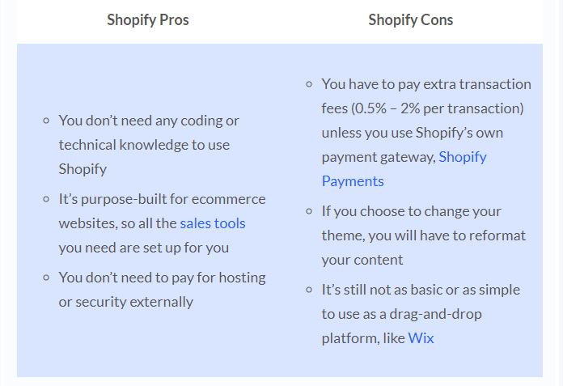

Slide 10
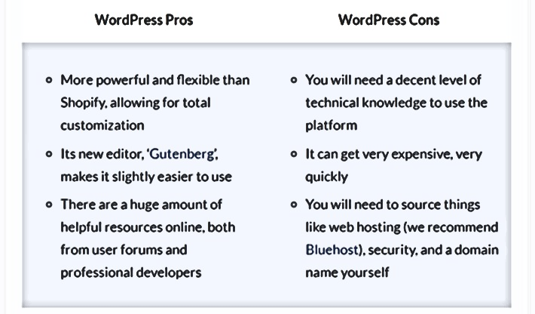

Slide 11
Thank you

